Slide 1
NETFLIX
Netlix Data Analysis

Slide 2
In this project, we:
1. Cleaned the data by handling missing values, removing duplicates, and converting data types.
2. Explored the data through various visualizations such as bar plots and word clouds.
3. Analyzed content trends over time, identified popular genres, and highlighted top directors,highlighted country with highest number of
comedy movies,average duration of movies etc .
This project involves loading, cleaning, analyzing, and visualizing data from a Netflix
dataset. We'll use Python libraries like Pandas, Matplotlib, and Seaborn to work
through the project. The goal is to explore the dataset, derive insights, and prepare
for potential machine learning task

Slide 3
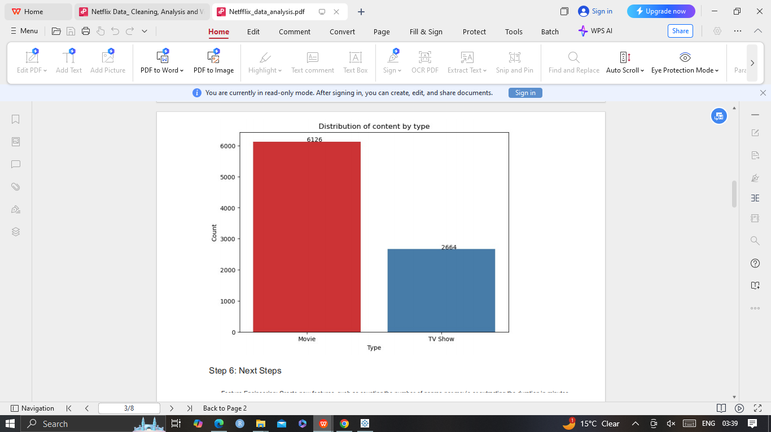
Content Type Distribution: ('Movies vs TV shows')
By this plot we can conclude that Netflixs distribution among Movies and TV shows ,where Movies are on the higher side of the graph compare to TV shows.

Slide 4
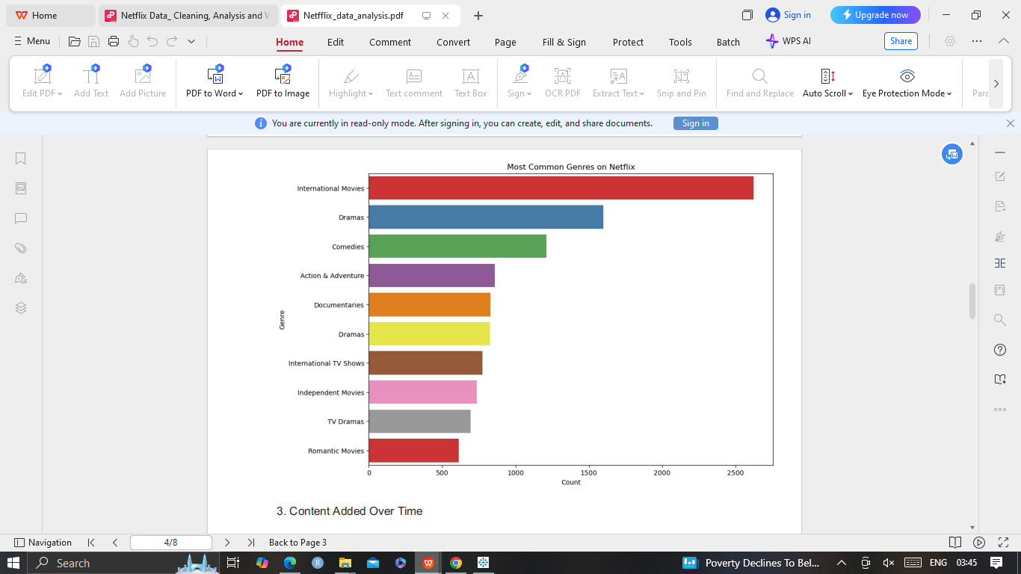
Most Common Genres
This chart conclude the most common genres on netlix app is International Movies

Slide 5
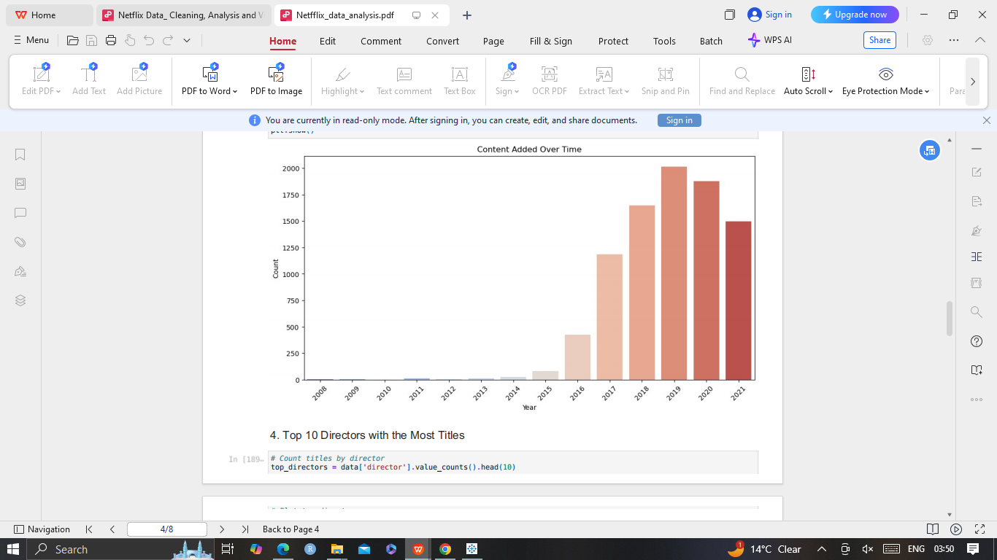
Content Added Over Time
This chart conclude the most content Added over time on Netfix app is in 2019

Slide 6
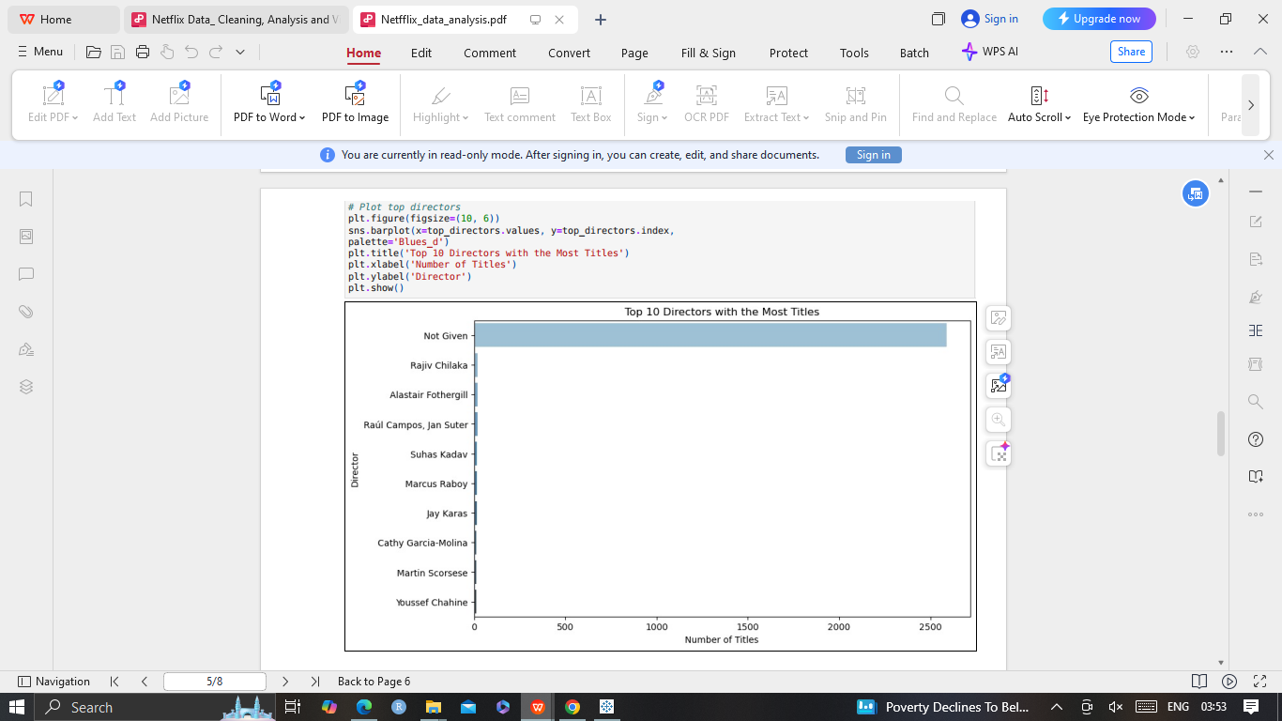
Top 10 Directors with the Most Titles
The following data analysis conclude that Top 10 directors with the most titls are not given.

Slide 7
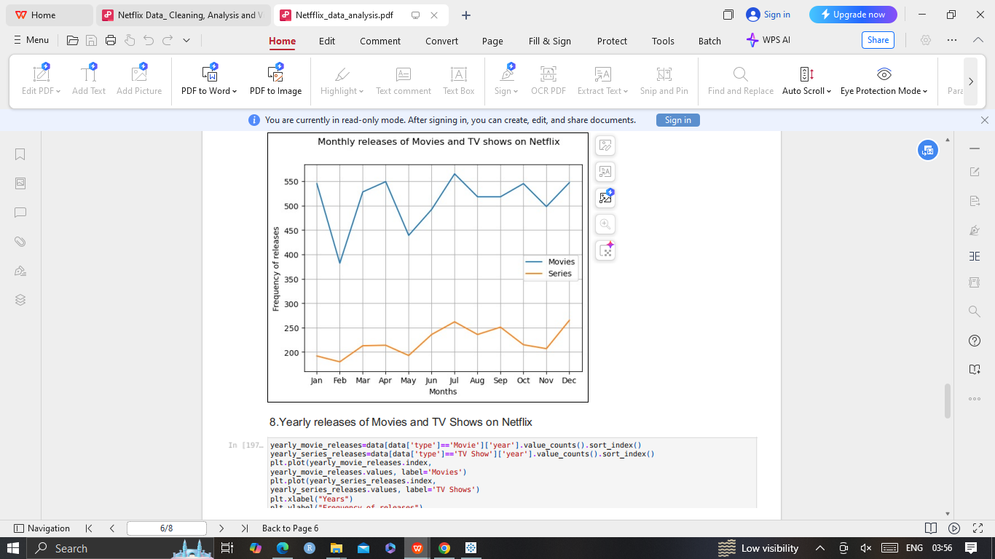
Monthly releases of Movies and TV shows
The following data analysis conclude that monthly release of Movies are higher than TV shows

Slide 8
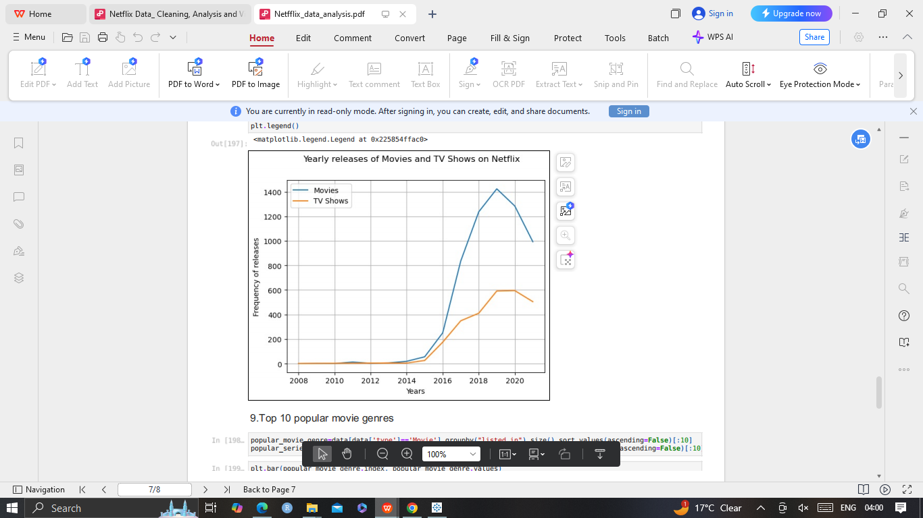
Yearly releases of Movies and TV shows
The following data analysis conclude that yearly release of Movies are higher than TV shows

Slide 9
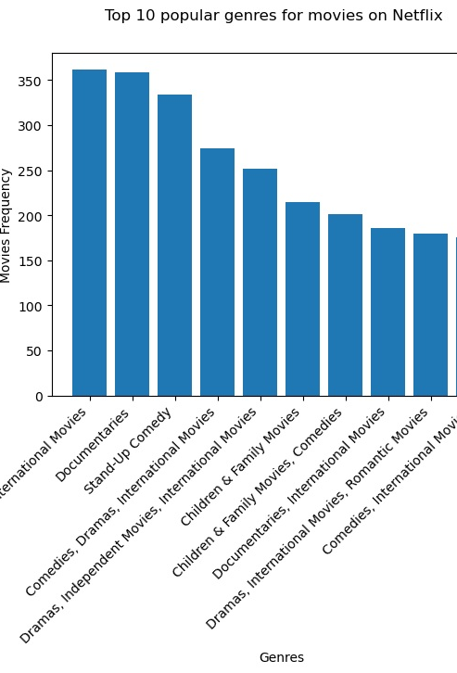
Top popular Genres for Movies
The following data analysis conclude that Dramas are highest Genre amogst all other genre.

Slide 10
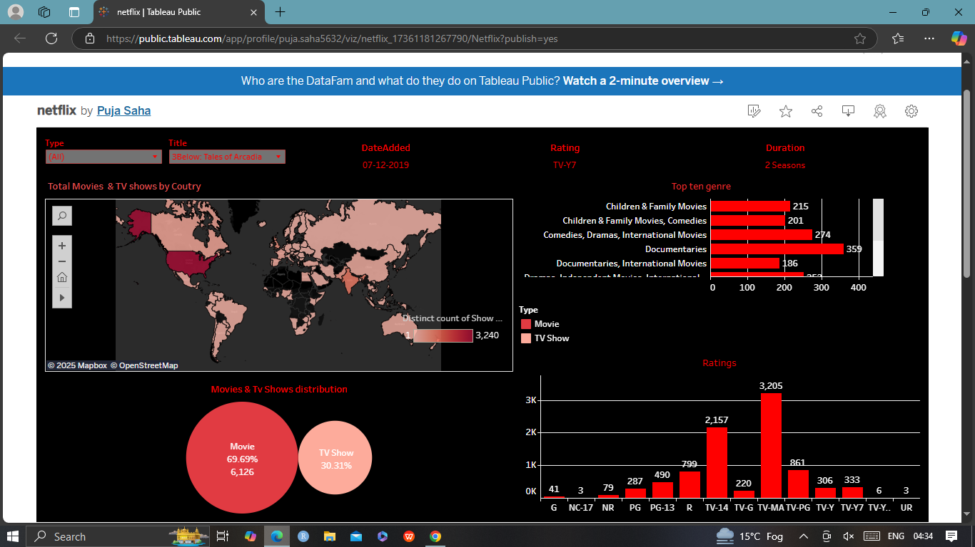
The following data analysis conclude that Dramas are highest Genre amogst all other genre.

